Slide 1
Social Weather
Mid term report Feb/28/2018
Jiexiao He, swarupa vaishampayan, hoshang charania

Slide 2

inevitability and contingency

Slide 3
Motivation
Social weather is a project predicting the social columns using different public media. Our purpose is making a time-series database, showing the changes of related items and find related patterns.
Our database aims to help people find pattern between data and find a way to merge the quick data(data by year and data by day).

Slide 4
Before aggregate
Quick data
Slow data
Minutes Day
Month
Year
Stock marketing Conflicts
Wars
GDP
School Enrollment
Injure in states
Income by race

Slide 5
Data structure
Fast data
Stock marketing in US | Conflict day and area
Slow data
Internet usage | GDP in US | Adolescent fertility rate | School enrollment | Energy use
Exports of goods and services | Market capitalization of listed domestic companies | Merchandise trade | Inflation consumer prices | Imports of goods and services
Military expenditure | CO2 emissions | Improved water source | Water productivity | Forest area
Births attended | Life expectancy | Contraceptive prevalence | GNI | Surface area
Happiness survey | Death rate | Income below poverty | Education by race | Immunization of measles

Slide 6
Models of algorithm
Prediction accuracy
day
Stock marketing
Conflict data
year
GDP,GNI, etc

Slide 7
What we did these week?
We looking for useful open-source dataset and merge the data together
We merge the quick data and the slow data together into Influxdb. The quick data include the stock marketing and we are doing another dataset for conflicts. We merge the fast data with the slow data year by year(Stock marketing use the average data gather 2000+ companies per year) We merge the quick dataset by day (Still doing since conflict date is not continuously)

Slide 8
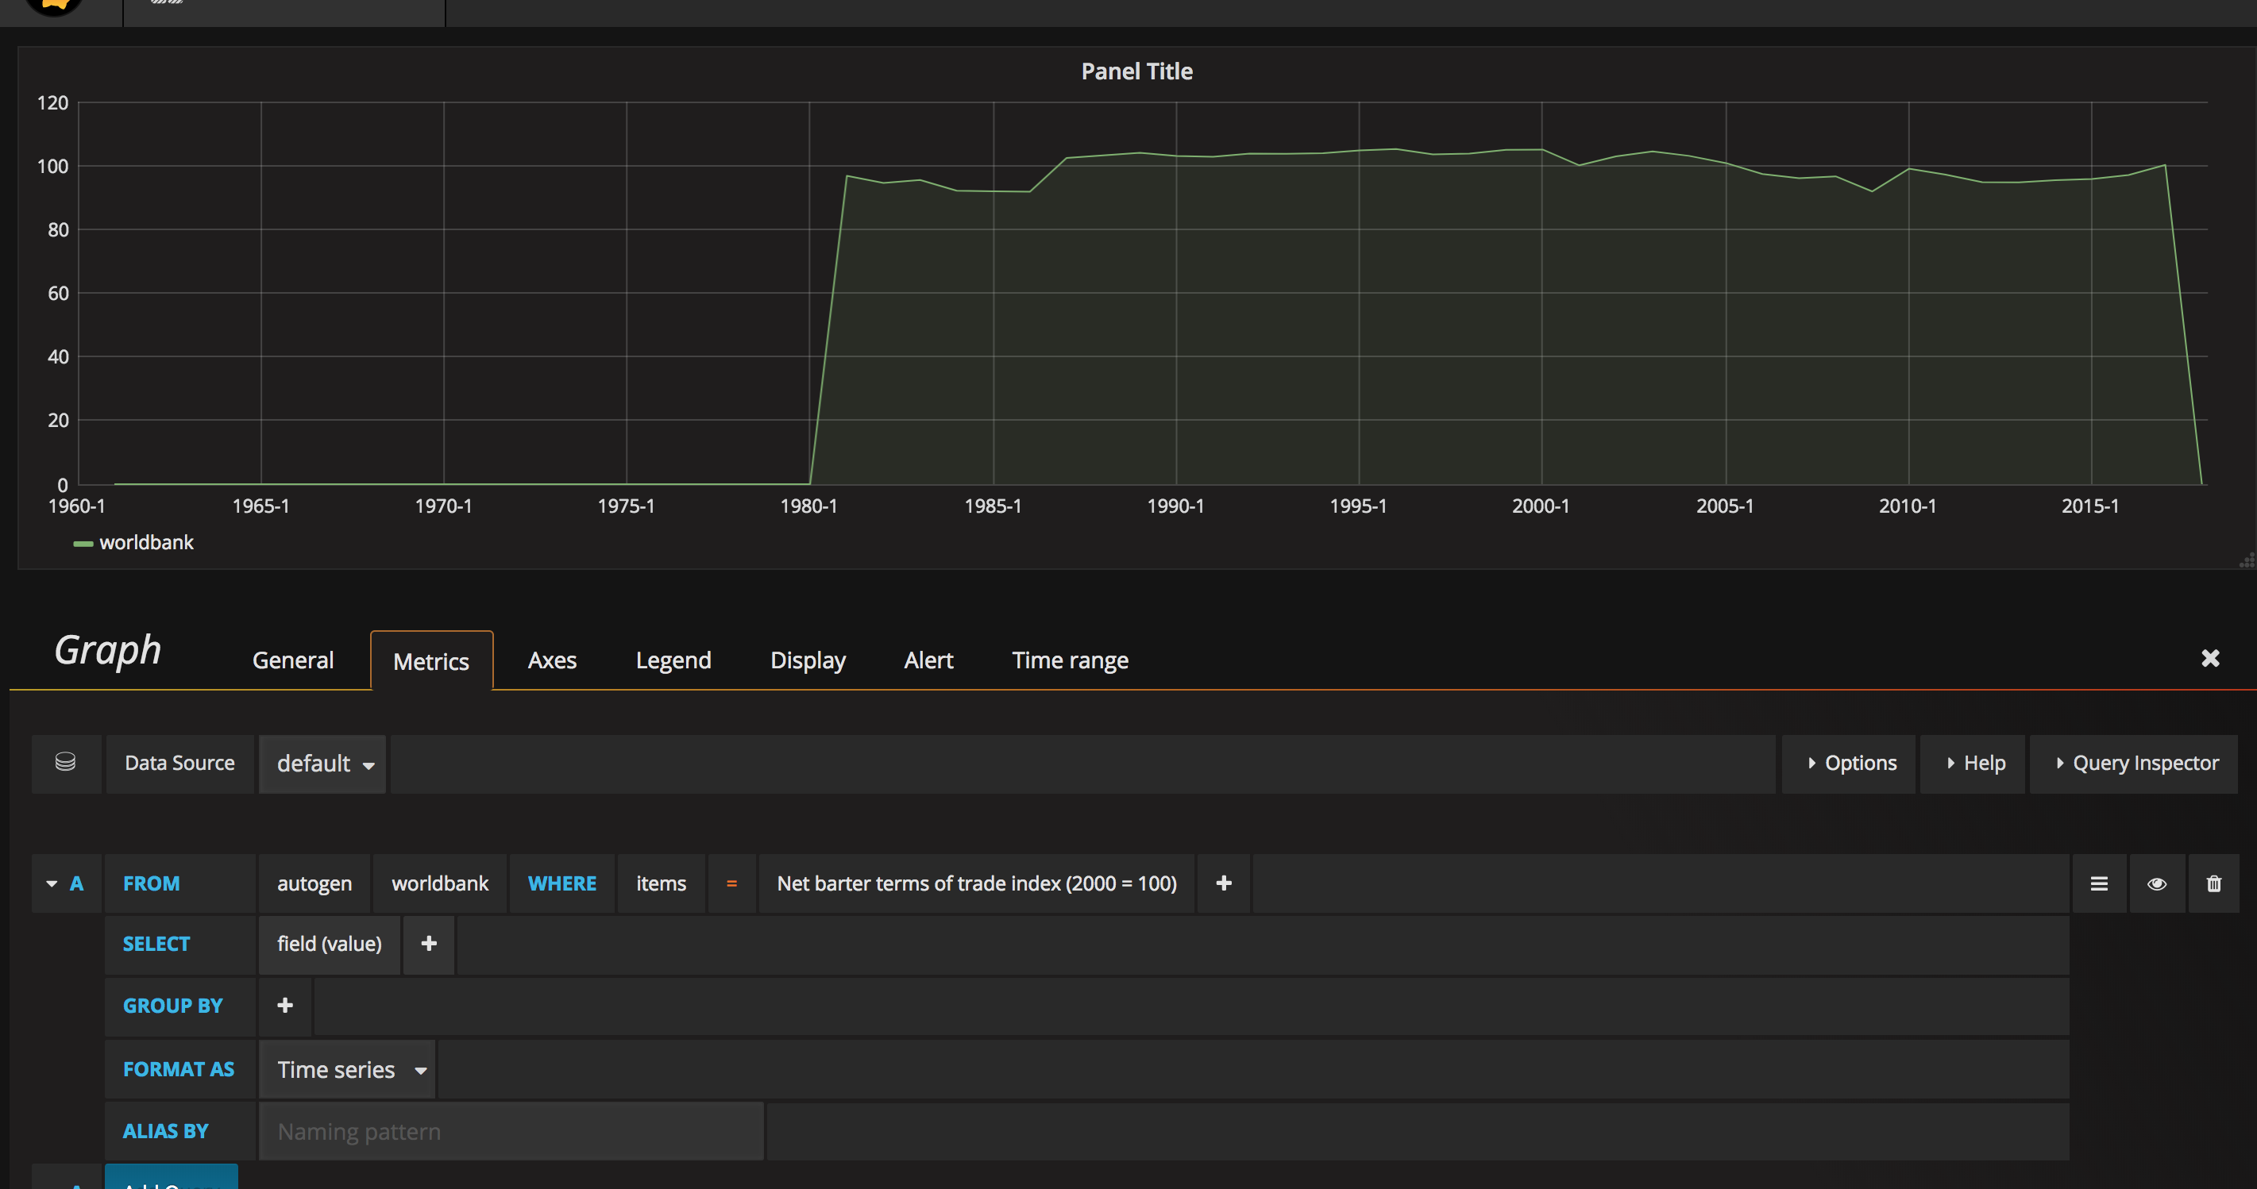
Visualization

Slide 9
Queries
What is the year the stock marketing decrease and people still have high happiness? What is the country in that year people have the highest happiness?
Will people feed more children when they feel more happy?
Will the enrollment of high education will influence people’s happiness?

Slide 10
Future work
Algorithm - PCA
A present website of our work(name?)

Slide 11
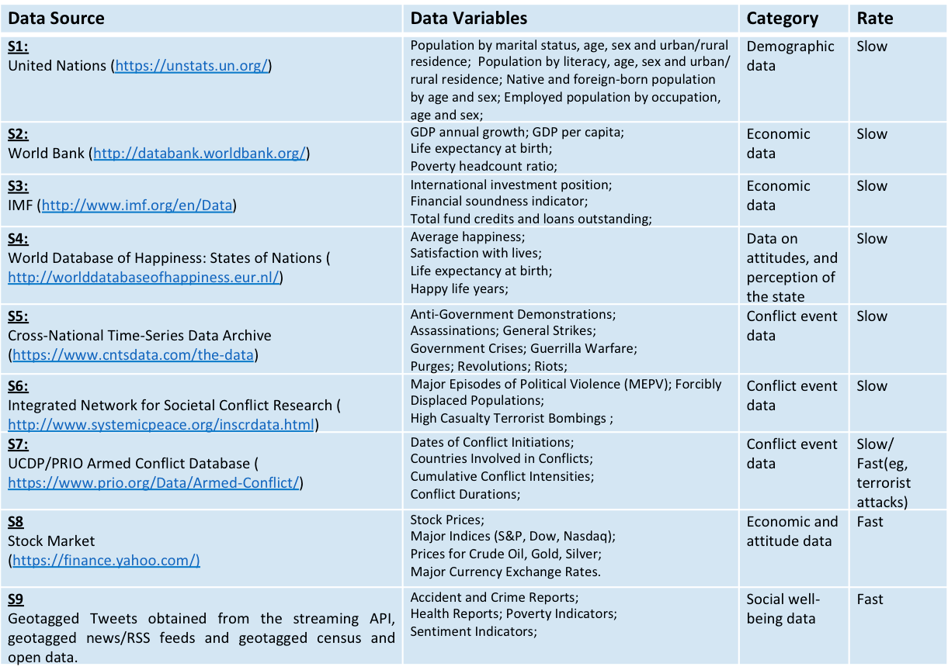
Reference data

